Slide 1

CW, RTTY, WSPR, JT9/JT65 Spotting/Skimming using RTLSDR & Hermes Lite SDR's
Doug Theriault – NO1D
Prescott Hamfest
June 2016

Slide 2
Overview / Agenda
What is Skimming, Spotting
Why is it interesting?
Skimming Modes, Types of Spotting
Software Applications and Spotting Sites
Hardware configurations for multi-band spotting
Using RTLSDR
Hermes Lite SDR
NO1D “SpotBox” – Multi-Band Skimming Rx's
Networking, Accuracy, Usage during Contesting
Data Mining signal reports
Hints, Kinks, Gotcha's
Links/References

Slide 3
Skimming & Spotting
Skimming: Automated decoding of signals
Skimmers operate on band segments, decoding multiple signals at once.
Typical BW from 3khz to 192khz
Identification of stations calling CQ or Beacons
Can also include non-CQ exchanges
Spotting: Publication of decodes to on-line sites/servers for multiple uses
Traditional DX cluster(s) spotting; Reporting a DX station on freq/mode
Identify Band openings
Propagation analysis; signal strengths vs time
Analysis of Antenna Performance
Space / Ionospheric Weather predictions

Slide 4
Skimming / Spotting Modes
Spotting Manually can be “any” mode
Skimming best suited for digital modes
CW, RTTY, PSK, WSPR, JT9/JT65
What about an AM/SSB/FM skimmer... Not yet...
Other modes?
This talk focuses on Multi-Band, Automated decoding of CW, RTTY, WSPR, JT9/JT65 modes

Slide 5
Software – in use by no1d today
CW Decoding | CW SkimServer v1.5 | VE3NEA, Alex, DX Atlas, $$$ (30d free trial) http://dxatlas.com
RTTY Decoding | RTTY SkimServer v1.2 | VE3NEA, Alex, DX Atlas, $$$ (30d free trial) http://dxatlas.com
WSPR, JT9, JT65 | HL Radio v0.132 (beta) | 2E0NNB, Alan Hopper, free Note: Windows only today http://www.ihopper.org/radio/
DLL for CW, RTTY | HermesIntfc.dll | K3IT, Vasily, free OpenHPSDR protocol interface https://sourceforge.net/projects/hermesintf/files/
RBN Aggregator CW and RTTY spots published to RBN | V4.12 | From Reverse Beacon downloads, free Note: Requires .NET 4.x http://reversebeacon.net
RTLSDR support (DVB-T/ RTL SDR USB sticks) | lib_rtlhpsdr | Rick (Author), N1GP, Doug NO1D, free http://github.com/n1gp/rtl_hpsdr http://github.com/dtheriault/hydra
OS Platform | Windows &/or Linux | Windows 8.x/10.x Ubuntu 14.04 LTS w/ Wine

Slide 6
CW & RTTY SkimServer(s)
Originally designed for QS1R SDR hardware
Several other SDR's now supported via additional .DLL
Up to 8 bands simultaneously @ up to 192Khz Rx bandwidth/band
May support 10 bands w/ new QS1R box release later this year.
Windows, but can exec under Linux/Wine
Requires x86 instruction set; SSE3
Performance, function of #CPU Cores/Memory
NO1D using 12 core x86, 16G AMD @ 3.6Ghz Linux Ubuntu 14.04LTS / Wine
Utilizes ~ 30% of system resources during contests

Slide 7
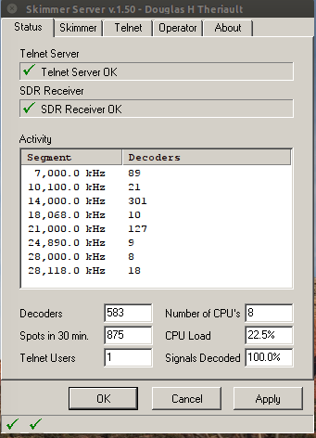
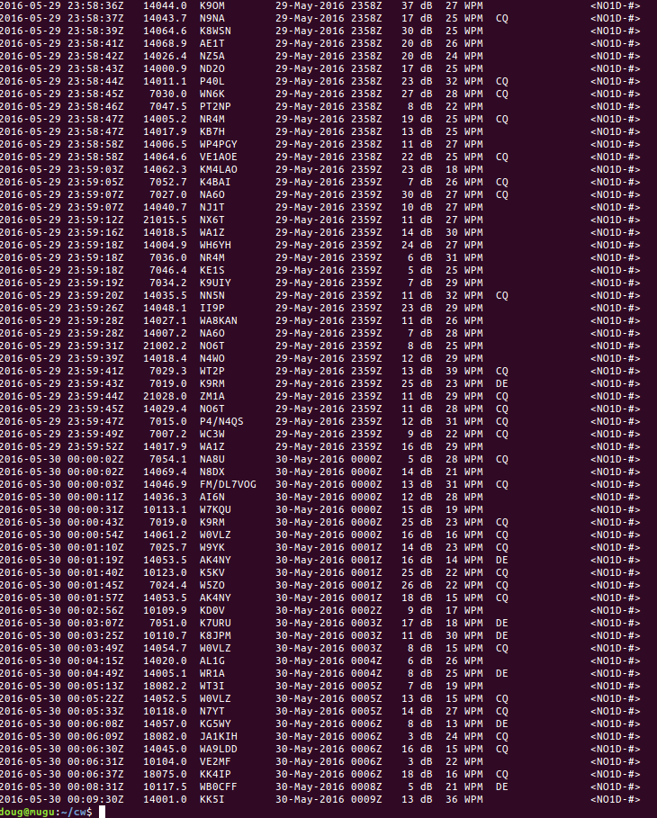
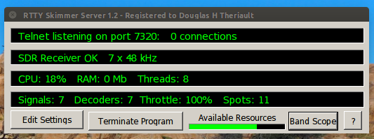
CW & RTTY Skim Servers

Slide 8
WSPR, JT9/JT65
Alan Hopper, 2E0NNB/M6NNB; HL Radio v0.132 (beta)
Leverages K1JT's WSJT software for decoding
Supports Tx as well as Rx (JT9/JT65)
Automatic upload spots to
WSPRnet.org & PSKReporter.info
Support 'n' Rx instances (really mean 'n' !!)
20 Simultaneous Rx in use today by NO1D
Each Rx slice 48Khz bandwidth from single SDR
Currently Windows only
Eventually plans OpenSource version, if possible
Specific to Hermes Lite (HPSDR protocol) SDR interface
Does work with RTLSDR using N1GP software

Slide 9
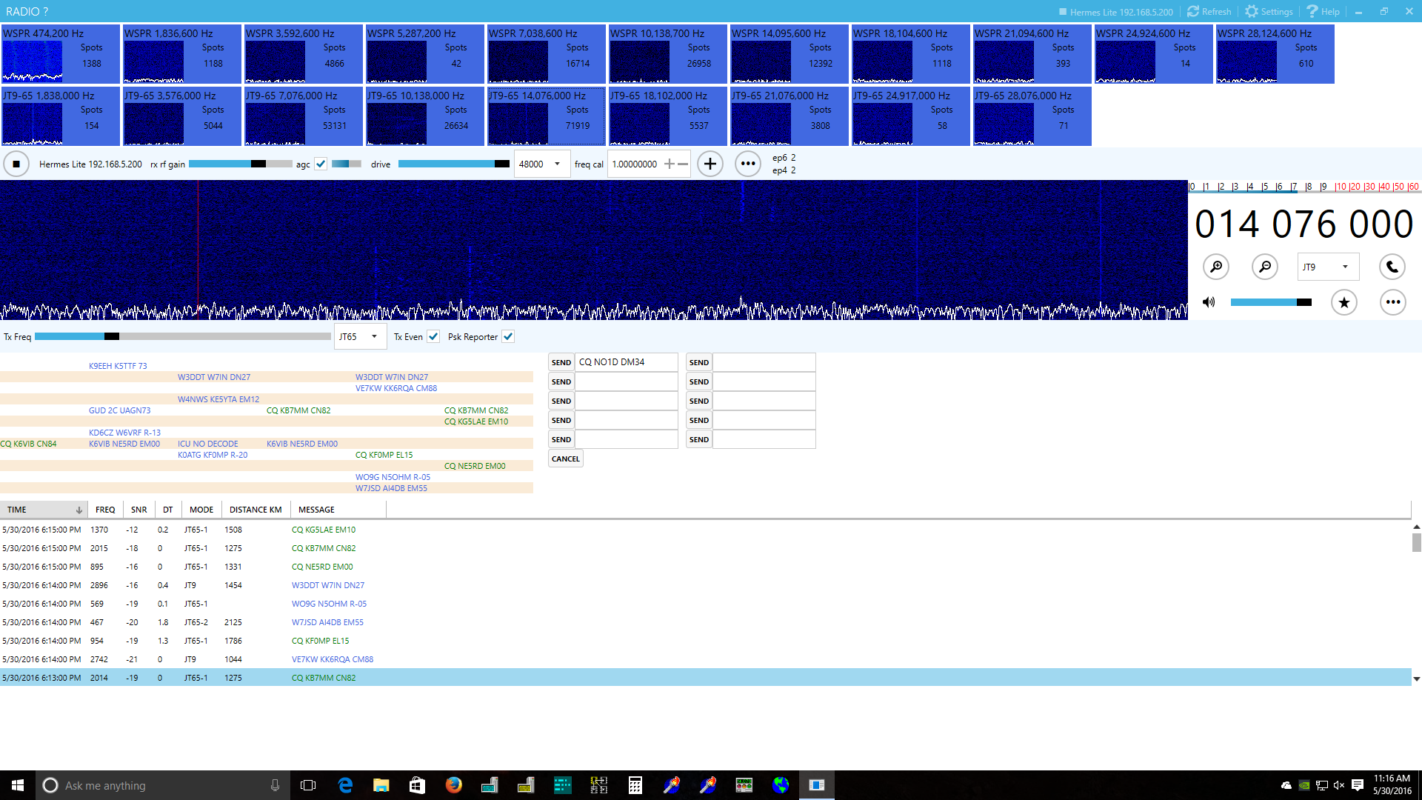
HL Radio v0.132 (beta)

Slide 10
Spotting Sites/Services
Modes | Name | URL
CW, RTTY (psk) | Reverse Beacon Network | http://www.reversebeacon.net/
WSPR | WSPR Network Weak Signal Propogation reporter network | http://www.wsprnet.org
CW/RTTY, Digital | PSK Automatic Propogation Reporter | https://pskreporter.info
Many Digital Modes | Ham Spots | http://hamspots.net

Slide 11
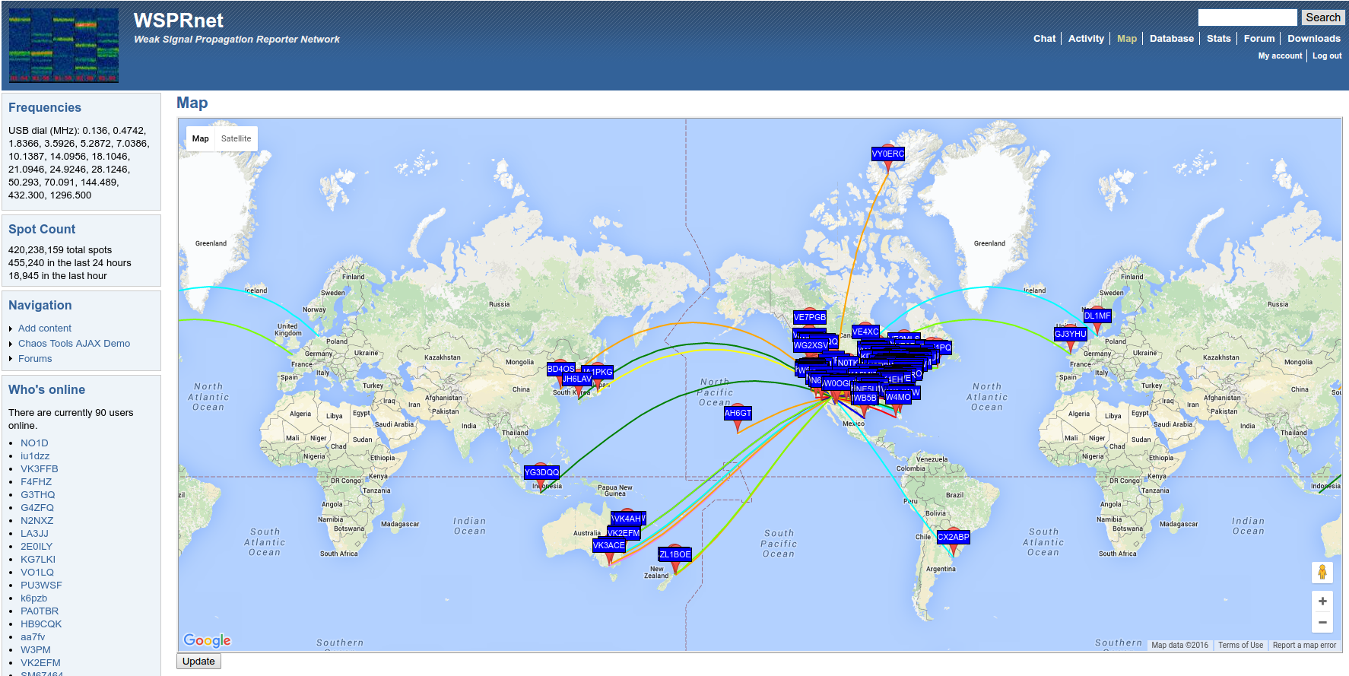
WSPRnet.org

Slide 12
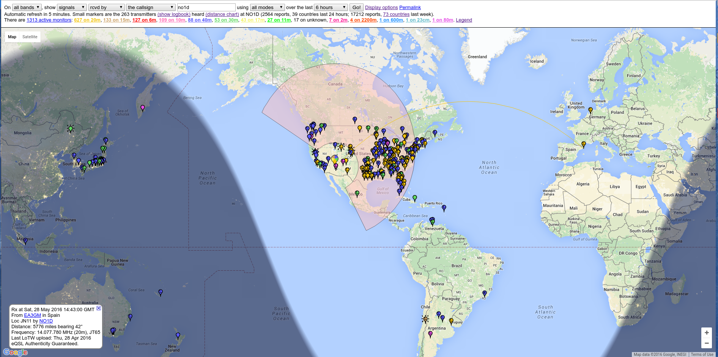
PSK Reporter

Slide 13
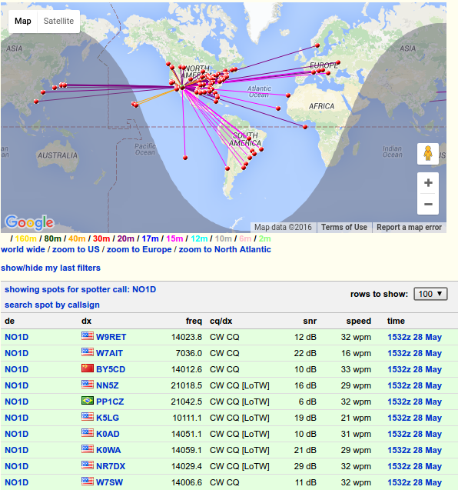
Reverse Beacon Net during CQ WPX Contest

Slide 14
Hardware
Almost any HF receiver/transciever
FlexRadio or Apache Labs SDR's
Secondary Rx's can be configured for spotting
Many smaller SDR's:
SoftRock's, QS1R's, RTLSDR, Hermes Lite, RedPitaya, SDR IQ, USRP...
Dedicated units so you don't tie up your primary rig
PC for decoding – Windows / Linux
Antenna
MF/HF Broadband for simultaneous multi-band op

Slide 15
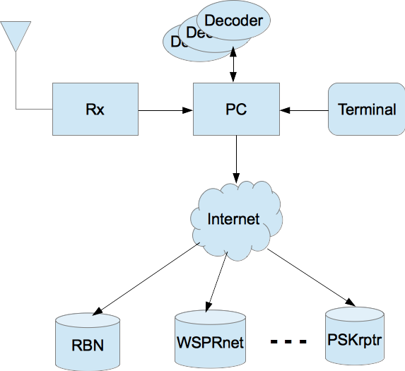
Basic Block Diagram
Interface varies
depending
upon Rx
Audio, USB,
or Enet 10/100/1000

Slide 16
How to do Multi-Band Spotting
Use single Rx and band-switch
Use Multiple Rx and Aggregate
Up to '7' RTLSDR (DVB-T) sticks
librtl_hpsdr and hermesIntfc.dll needed to aggregate I/Q streams (formats into hpsdr packets)
Use HW which can instantiate multiple Rx's
Flex, QS1R, Apache Labs, USRP; can be pricey
Hermes Lite SDR's; < ~$250 for 32 Rx !!!
Typically FPGA based platforms supporting multiple Rx slices

Slide 17
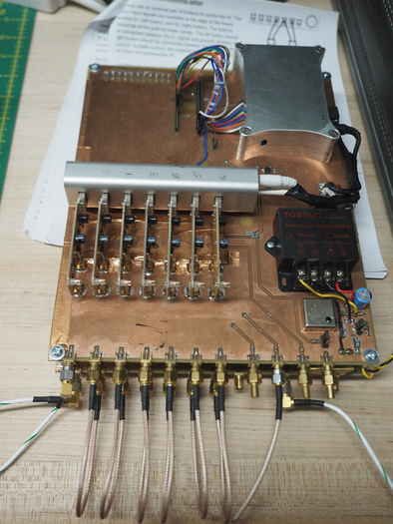
Spotting w/ Hydra RTLSDR
Well known DVB-T sticks
Using RTLSDR software stack
8-bit A/D for reasonable DNR
Great entry device for getting into SDR
Lots of Software available
Yes, you can aggregate several sticks for multi-band spotting
N1GP librtlhpsdr software makes this all possible !
Shown is Hydra, 7 stick RTLSDR Spotting Rx.
Utilizes oDroid C1 embedded ARMv7 CPU
Sticks Rx from ~20mhz to 1.7Ghz, so for HF, requires up-converter mixer
Shown is (2) board set, mixer on bottom

Slide 18
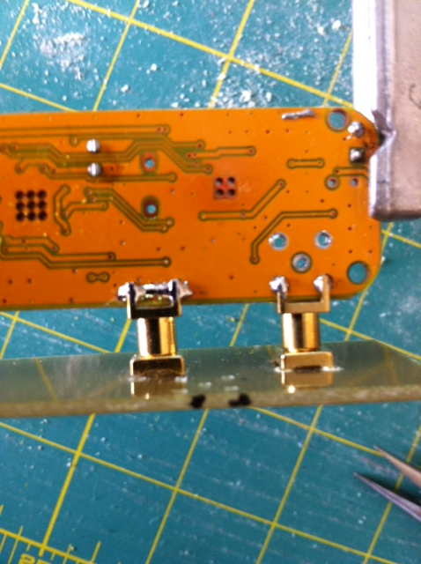
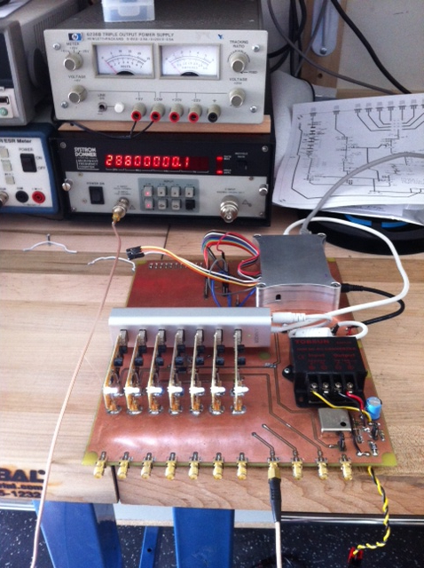
RTLSDR - limitations
8-bit A/D limits DNR
USB interface limits overall bandwidth 'n' sticks can be processed by CPU
Sampling rate (28.8Mhz) accuracy varies; due to ppm of crystal or xtal osc chip.
Power hungry, each stick, 500ma
Embedded system; oDroid C1 w/ Gbe was best compared to rPI, Jetston TK1, other oDroids
Software utilizes x86 or ARM NEON intrinsics instructions for fp/vector processing; FIR filter processing limits # sticks which can be processed.
Main bd. Implements PLL to generate 28.8mhz and 125Mhz LO clocks

Slide 19
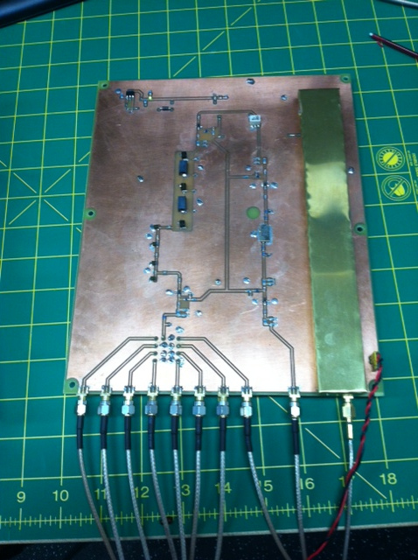
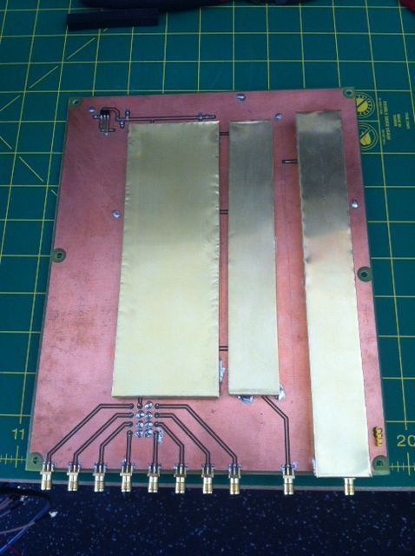
RTLSDR – mixer.
Initial prototype used a HamItUp converter
Developed Mixer w/ filters and multi-port coupler
LPF, BCB filter on front end
125Mhz LO w/ SAW filter
ADE6+ Mixer
IF Filtering, MMIC's to overcome losses into mini-circuits Multi-Coupler
Home brew 2-sided PCB
Not as flat across HF as designed, Need 4-layer PCB to get 50/75ohm transmission lines
Good Learning Experience !
More bands @ low cost... how...?

Slide 20
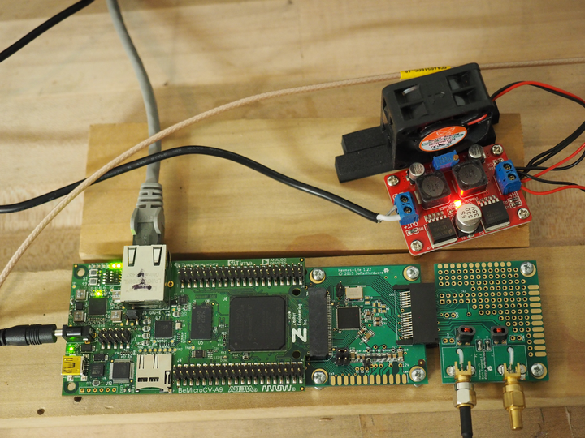
Hermes Lite SDR
FPGA Based SDR
Based off openHPSDR.org Hermes project
Lead by Steve Haynal KF7O
OpenSource effort with many famous hams contributing
Direct conversion/sampling SDR; minimal front end
Supports Tx as well as Rx
12-bit AD9866 A/D converter used in set-top boxes; good to 36Mhz
Uses COTS FPGA engine, BeMicroCVA9 shown here...
With CVA9, can instantiate 32Rx on single board !!! Wow !!!
V1.22 shown here, 2x board set available off Tindie
PCB only, but easy to assemble if not adverse to SMD construction
Next gen v2.0 in development

Slide 21
Hermes Lite – Low cost Performer !
FPGA implements a minimal networking stack
HW supports Gbe speeds
Software limitations experienced in oDroid are overcome by fast FPGA processing
Direct Sampling A/D means no mixer challenges
Lower power draw per Rx slice
Supports HPSDR protocol
Can be used as VNA
Depending upon FPGA engine selected, can scale up to 32 Rx slices
World wide OpenSource project; hams from many continents supporting effort.
Verilog and PCB files available
Purchase from Tindie, OSH Park
V2.0 goal uses Altera Max10 FPGA for more integrated solution.

Slide 22
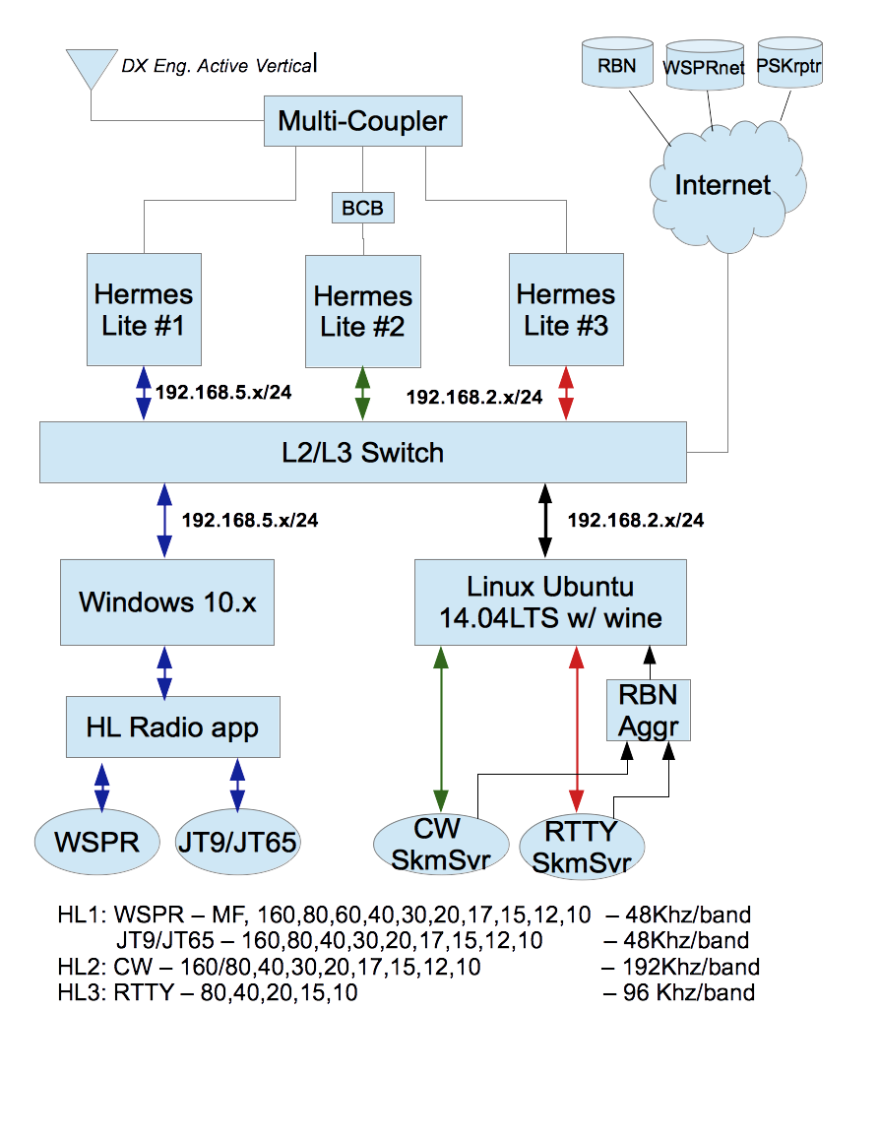
NO1D spotting config
33 – 34
Active Rx's !!
MF thru 10m

Slide 23
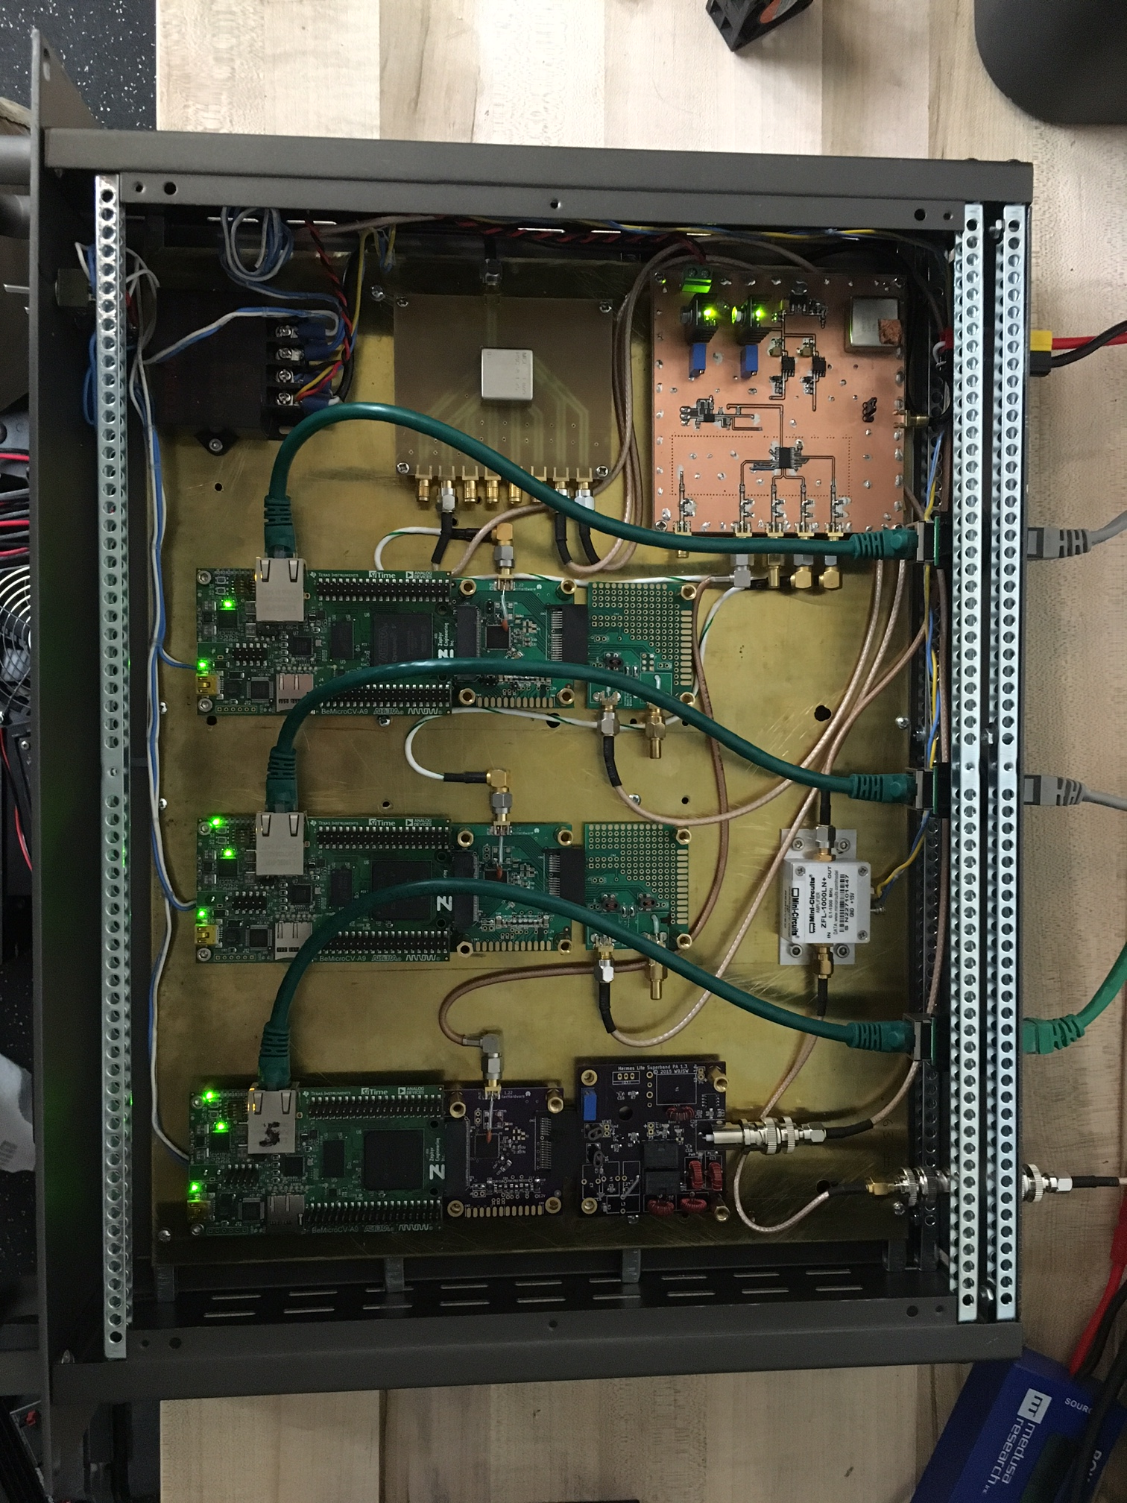
NO1D SpotBox v1.0

Slide 24
Networking Bandwidth
WSPR, JT9/JT65 with 19 Rx slices @ 48Khz bandwidth generates solid 48Mb/s
CW w/ 8 bands @ 192 Khz; ~46Mb/s
RTTY w/ 7 bands @ 48Khz; ~ 36Mb/s
Primarily 1 way traffic; initial 2 way required during discovery & configuration
UDP, can be lossy over poor network infrastructures.
Several hundred Mb/s capability needed by your PC and infrastructure
You may see issues running over wifi
NO1D setup utilizes L2/L3 router to split and segment traffic
Not a requirement, useful to me during development

Slide 25
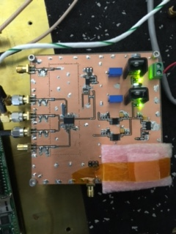
Frequency Accuracy
RBN checks for +/- 100hz
Measured against well known stations running GPSDO clocked nodes
RBN RTTY measures down to 10hz resolution
WSPR decoding w/ .1 Hz resolution !
Highly accurate & stable, SDR sampling rates desired
Should not drift over temperature changes in environment
HL Clock varied w/ temperature
Spotting users really want accurate frequencies !
Aliasing issues with RTLSDR's
Prototype PLL using TCXO
Can be fed from Rb standard
Spots w/in +/- .5Hz
TCXO still bit weak, varied w/ temperature (hot garage)
Next prototype true GPSDO

Slide 26
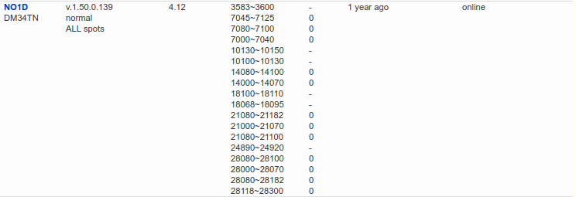
RBN Detail Report
Lists RBN active and inactive spotters
Lists SW versions used, spotter's grid square
Band segments configured
And +/- freq. 100hz resolution.

Slide 27
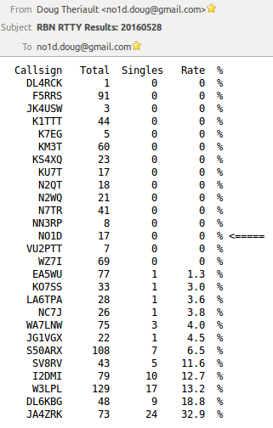
Measuring Performance
Consider joining RBN operators list if you publish spots to RBN
Several members publish performance data after contests
RBN and WSPRnet.org offer raw data downloads
Nightly processing of raw CW and RTTY data performed
Looking for # Spots which are “unique”; as indication of accuracy
Ie: I received station, but nobody else did, chances may be its bad callsign. Not perfect as you may be only one to Rx that callsign; 10m and above
Typically compare myself to WA7LNW Utah who uses QS1R and much better antenna system !
Work in process, need to put raw data in db for more complicated searches
Todays scripts (linux) can take several days to run after a major contest !

Slide 28
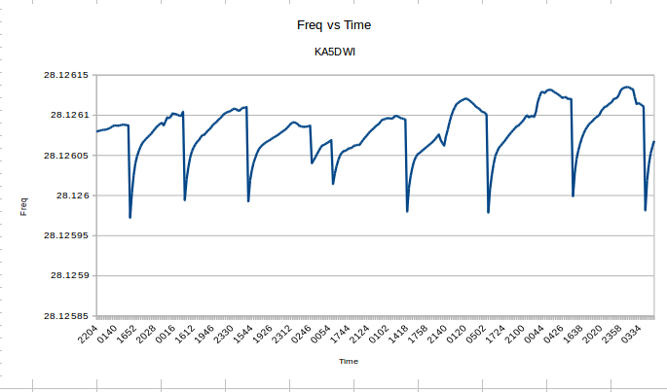
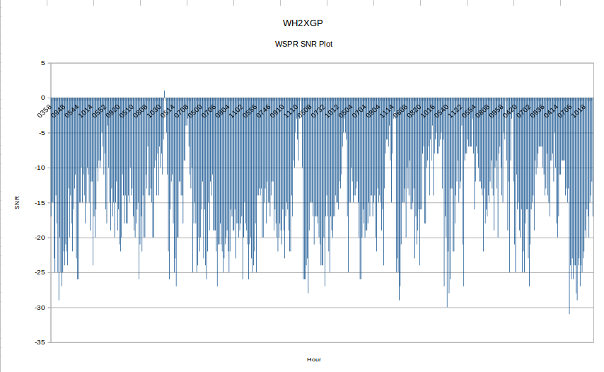
Data Mining
Raw data contains frequency and SNR readings per spot
Example KA5DWI, 10m WSPR beacon frequency over time
Noticed strange freq shift
Turned out to be A/C unit turning on in afternoon
WH2XGP, 630M SNR plot over time.
MF beacon propagation over multiple days.
Correlate w/ space wx data sets for further analysis
Have had many MF and Beacon users email/thank me for spotting their stations over time.

Slide 29
Hints/Kinks, Gotcha's
If you Tx and intend to spot, mute/turn off spotting Rx while xmitting.
RTLSDR weak FIR filter can result in Aliasing errors; esp. seen on 10m beacons !
Spots off by Nyquist rates.
Watch out for harmonics/aliasing across HF bands
Ran WSPR beacon while spotting and Tx would overload my Rx
Some Rx/Decoders will mis-spot calls on wrong bands. Mis-configs. Check your spots against others to see if you're accurate.
CW/RTTY band segment configurations can be tricky
Null out frequencies that are problematic
Watch contest calendar and update band segments.
Consider turning off RTTY during CW, or CW during RTTY or config band segments so they don't overlap
Use aggressive mode esp. for RTTY to prevent bad spots.
You may need a BCB filter if you're not spotting on MF and experience overloading
Don't overload Rx front ends.

Slide 30
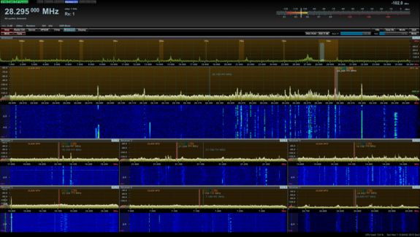
CuSDR - Visualization GUI
One of many GUI's
Supporting HPSDR protocol
7 Rx's across HF
Wideband FFT
Visualize quality of bands
Esp. during contests and sprints
Identify problems in Rx path

Slide 31
Futures – NO1D SpotBox v2.0
Build a HL compatible Rx platform specific to Spotting activities
Reduce need for multiple HL boards
Include lessons learned during past year; clocking stability...
Eliminate need for BeMicro CVA9 board(s); getting difficult to source
Single PCB w/ Altera Cyclone V, Gbe, AD9866 and Front End...
Include GPSDO or 10Mhz input clock
Keep it low cost
If using CycloneV, BGA package FPGA... would be built board, not in kit form
Trick clients into thinking there are multiple HL boards
Similar to 'Tee' SW used today for CW/RTTY skimmers on Windows
Leverage Multi-Netting and implement as middle-ware SW solution
Use a 2x Gbe embedded board to host code
Or... modify CVA9 Verilog/RTL to implement this approach in HW.
In addition, learn/build a solution for 6m, 2m bands

Slide 32
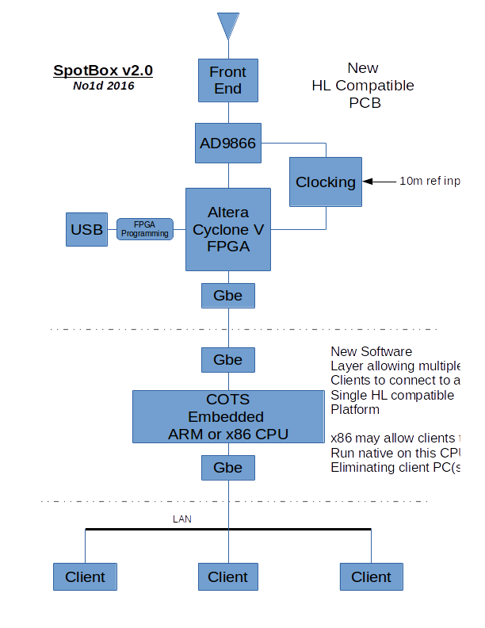
Spot Box Block Diagram - prelim
Looking for 2x Gbe Embedded CPU; low cost ideally
UDOO Kickstarter project perhaps
Would be used to develop SW and possible use in end solution
X86 platform might allow clients to execute natively and eliminate separate PCs need in the shack.
A single box solution for integrated spotting solution...

Slide 33
A Few URL's
What | Where
Hermes Lite Project | https://github.com/softerhardware/Hermes-Lite
BeMicro CVA9 | https://www.arrow.com/en/products/search?q=BeMicro&filters=
HL Radio | http://www.ihopper.org/radio/
Skimmer Server SW | http://www.dxatlas.com/ (includes download info for K3IT's HermesIntfc.dll)
Spotting Sites | http://www.reversebeacon.net/ (includes download for rbn aggregator app) https://pskreporter.info/ http://wsprnet.org/drupal/ http://hamspots.net/
Hermes Lite Boards | https://www.tindie.com/ (search for Hermes Lite)
RTLSDR software | https://github.com/n1gp/rtl_hpsdr (orig code, bit old now) https://github.com/dtheriault/hydra (contact me for help on using this suite )
HPSDR GUI client (Rx only) | https://github.com/n1gp/cudaSDR (fork from vk5abn) https://github.com/dtheriault/hydra (cuSDR from n1gp w/ earlier HL mods)

Slide 34
Closing, Contact Info
Contact me if interested in experimenting with HL, RTLSDR or spotting. Glad to talk further...
Esp. if you want to collaborate on building a SpotBox...
Spotting can be fun for those of us living in tight HOA developments w/ limiting Tx capabilities.
Although I'm committed to getting on air with JT9/JT65 this year with 1-5W . Perhaps using Rich K8NDS very cool loops !
QRZ.com/no1d
Email: no1d.doug@gmail.com

